Slide 1
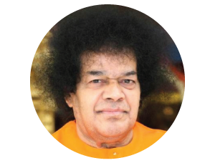
93rd Birthday Celebration of Bhagawan Sri Sathya Sai Baba

Slide 2
93rd Birthday Celebration of
Bhagawan Sri Sathya Sai Baba
Theme : Love in Action ~ Experiencing Divinity ~
Date : Nov 17th Saturday 10:00 AM – 4:00 PM
Venue : Shiva – Vishnu Temple, 1232 Arrowhead Ave, Livermore, CA
Coordinators : Venu Banda (CSJ), Anuradha Somashekar (Fremont)
More @ http://region7saicenters.org/birthday/2018/index.html

Slide 3
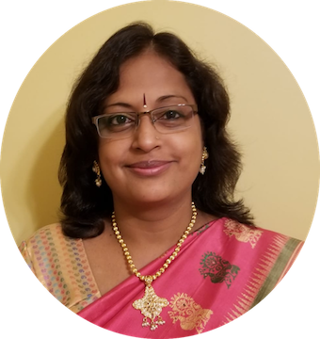
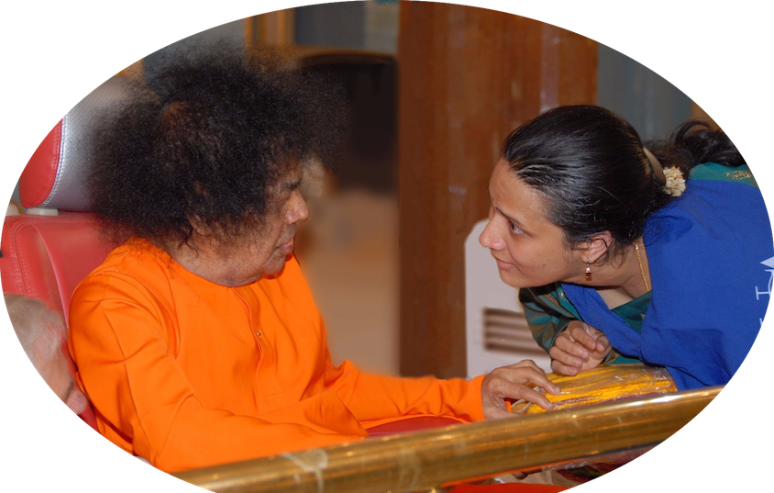
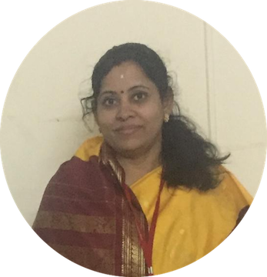
Inspiring Speakers from
Sri Sathya Sai Institute of Higher Learning (SSIHL)
Mrs. Lakshmi Raman
Mrs. Anuradha Venkateswaran
Mrs. Sudha Subramaniam

Slide 4
Few things about Birthday Celebration…
Kindly request volunteers to sign up online or at service desk at centers
http://region7saicenters.org/birthday/2018/Volunteer.html
Volunteer signup last date is 10/28, Sunday
Volunteer Orientation – Date will be communicated later
All devotees are required to Register Online for seating, lunch and logistics planning - http://region7saicenters.org/birthday/2018/Registration.html
All are requested to follow the dress code as prescribed by Bhagawan Sri Sathya Sai Baba

Slide 5
Program…
TIME | ACTIVITIES
10:00am - 10:45am | Devotional Singing
10:45am - 11:00am | Welcome and Speaker Intro
11:00am - 11:25am | Talk by Mrs. Lakshmi Raman
11:25am - 11:50am | Talk by Mrs. Sudha Subramaniam
11:50am - 12:20pm | Talk by Mrs. Anuradha Venkateswaran
12:20pm - 12:30pm | Cake cutting
12:30pm - 1:30pm | Lunch
1:30pm - 1:45pm | Recognizing Centers
1:45pm - 2:00pm | Service Presentation
2:00pm - 3:30pm | Musical program by Speakers
3:30pm - 3:45pm | Swami's Discourse
3:45pm - 4:00pm | Closing prayers

Slide 6
Thank You
&
Loving Sairams

